Slide 1
Function And Recursion

Slide 2
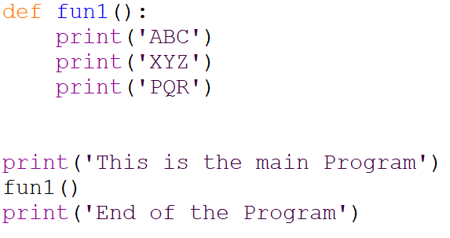
Function (Reuse Code)
A function is a block of code which only runs when it is called. You can pass data, known as parameters, into a function. A function can return data as a result.

Slide 3
The main reasons for using functions are: To improve the readability of code.
Improves the re-usability of the code, same function can be used in any program rather than writing the same code.
debugging of the code would be easier if you use functions (errors are easy to be traced).
reduces the size of the code, duplicate set of statements are replaced by function calls.

Slide 4
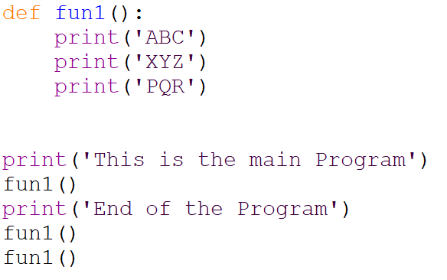

Slide 5
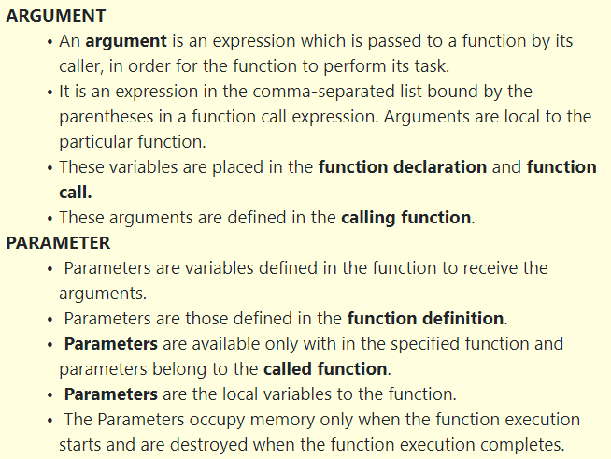

Slide 7
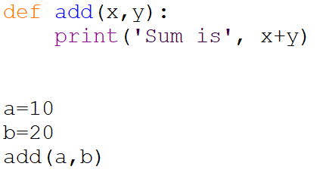

Slide 8
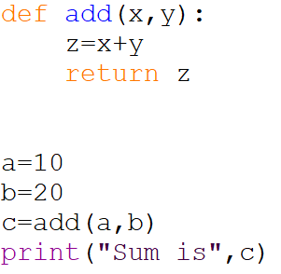

Slide 9
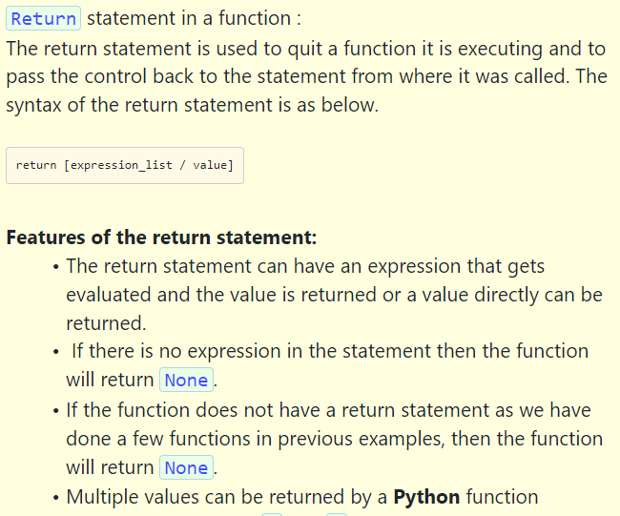

Slide 10
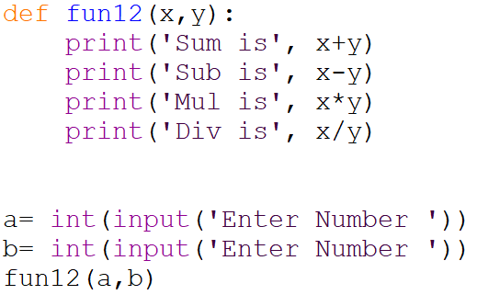
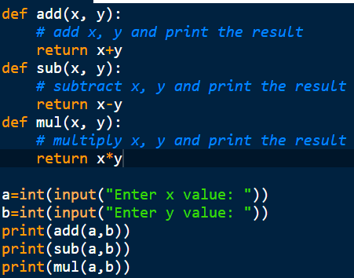

Slide 11
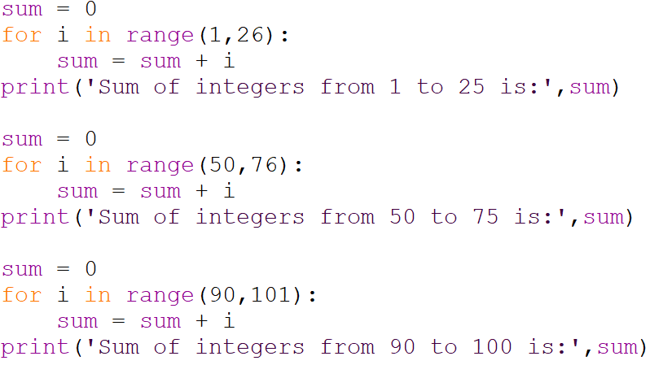
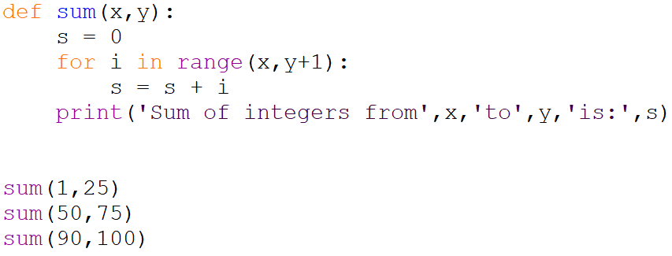


Slide 12
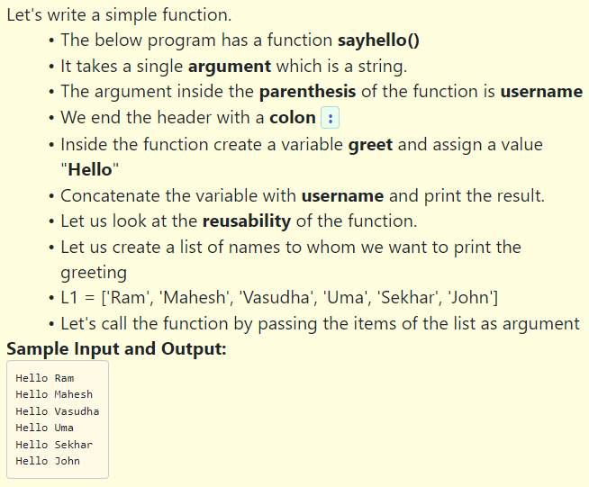

Slide 13
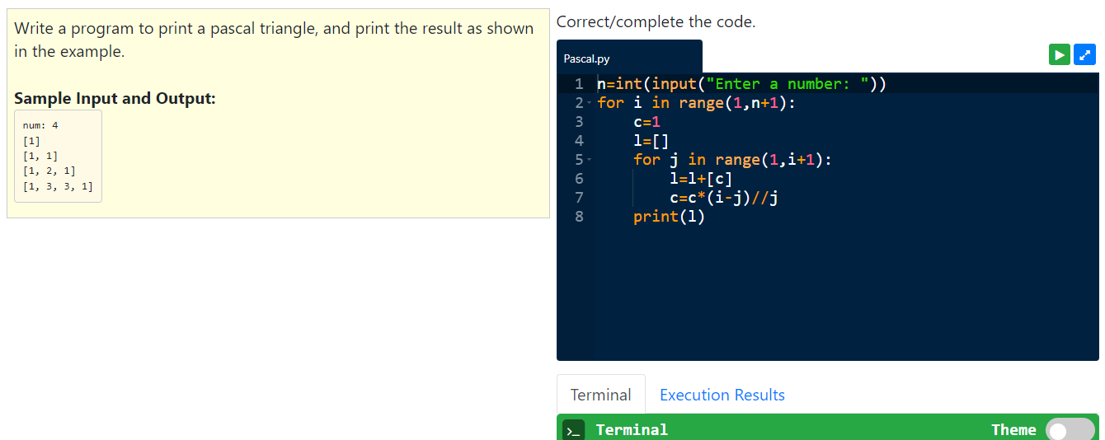

Slide 14
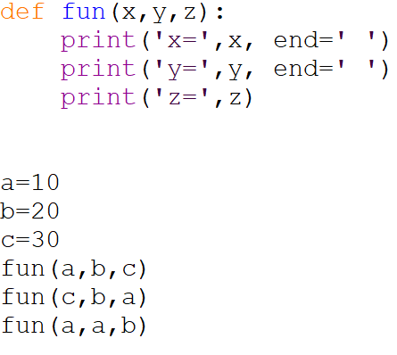
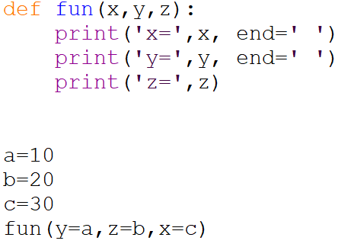
Keywords Arguments
Whenever a function is called with some arguments, the arguments passed get assigned to the parameters of the function and the function uses these parameter values inside the body of the function.

Slide 15
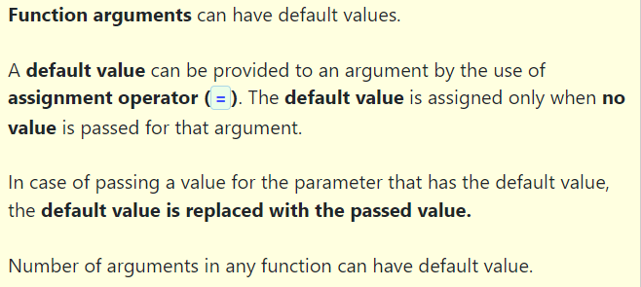
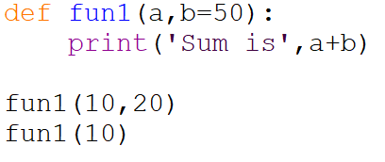
Default Arguments

Slide 16
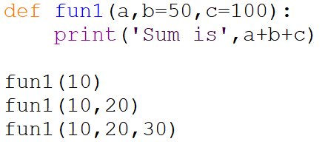

Slide 17
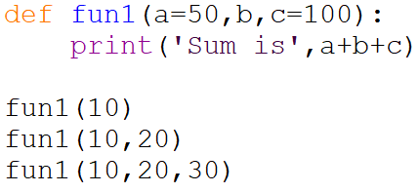

Slide 18
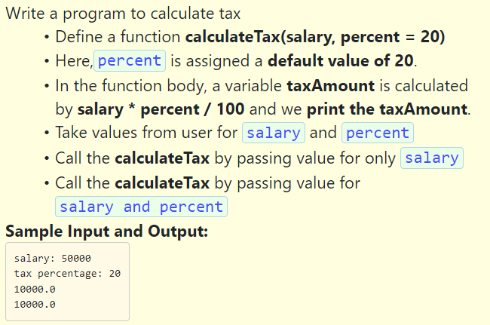

Slide 19
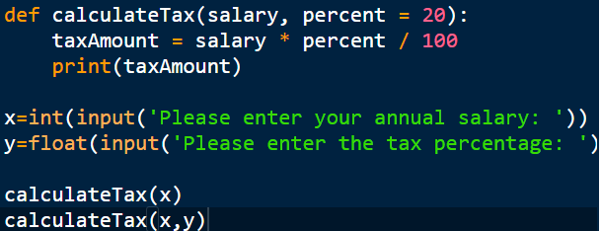

Slide 20
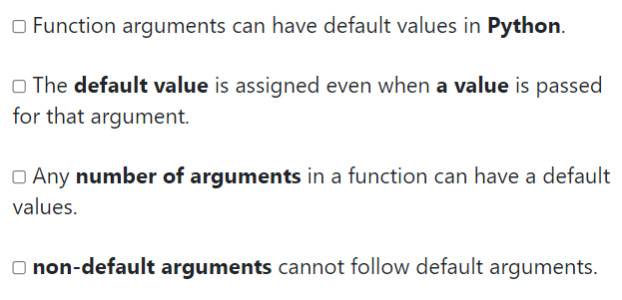
Chose the correct options

Slide 21
Arbitrary/Variable length arguments :
In some cases, the user may not have an idea of the correct number of arguments that will be passed into a function During of execution. This kind of scenario can be dealt with a function being defined for an arbitrary number of arguments and then called. This is done by using an asterisk (*) in the function definition, where we use this before the parameter name to specify that these type of arguments can be many. The function body should be written in such a way to handle these arguments.

Slide 22
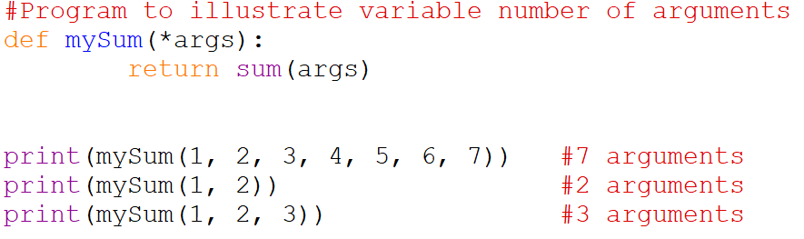

Slide 23
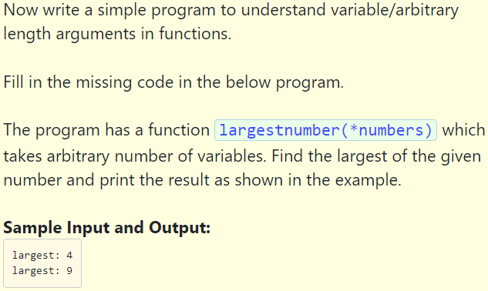

Slide 24
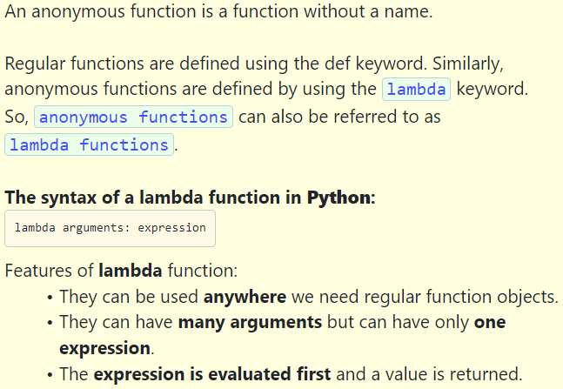

Slide 25
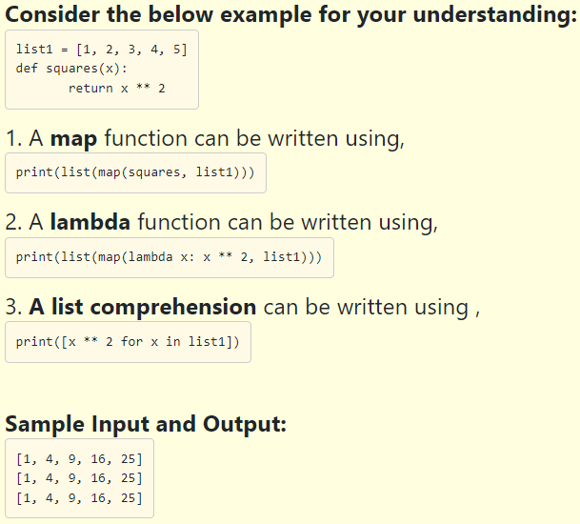

Slide 26
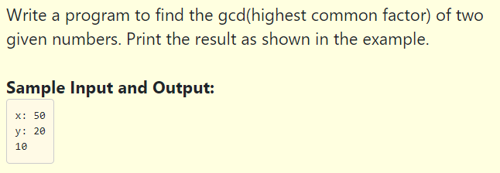
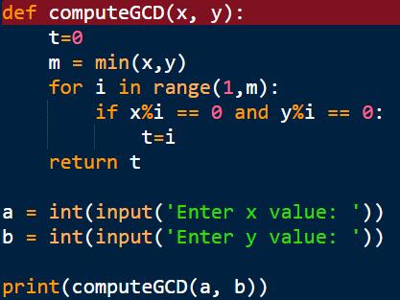

Slide 27
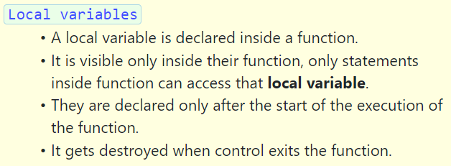
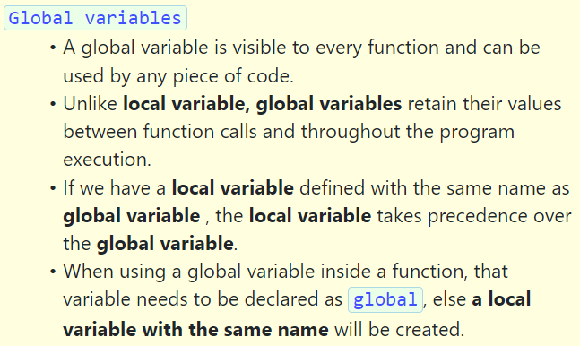

Slide 28
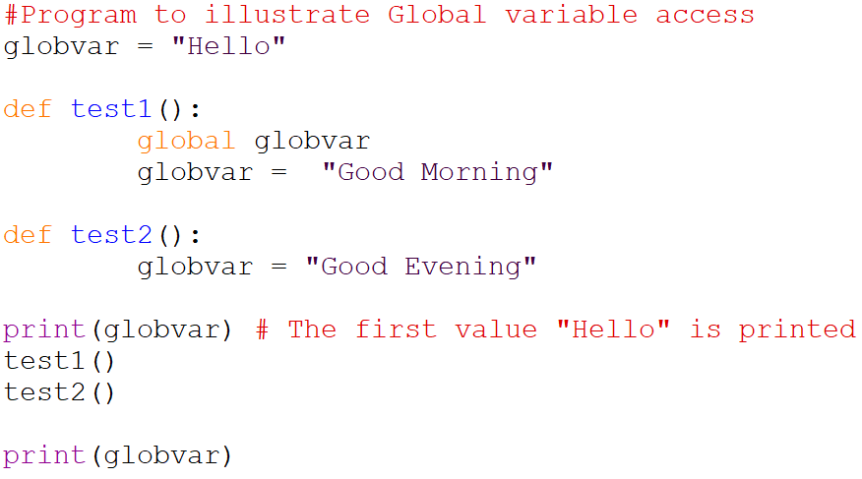

Slide 29
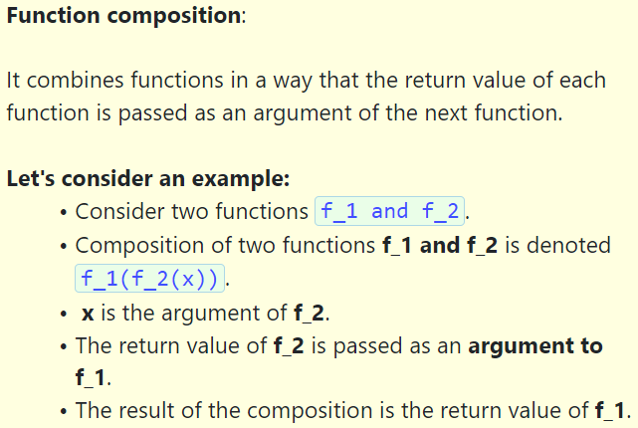

Slide 30
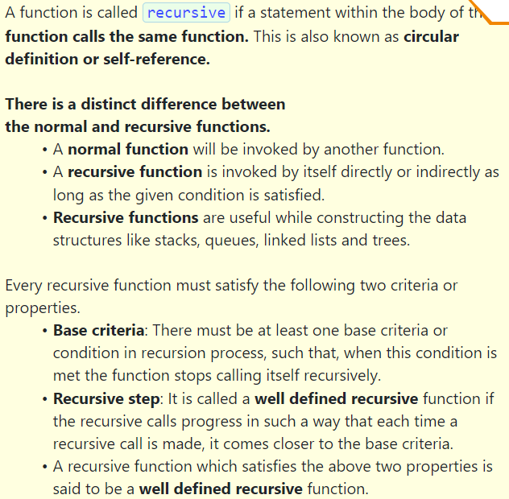
def fun1():
print("ABC")
def fun2():
print("XYZ")
fun1()
print("PQR")
print("Main Function")
fun2()
print("End program")

Slide 31
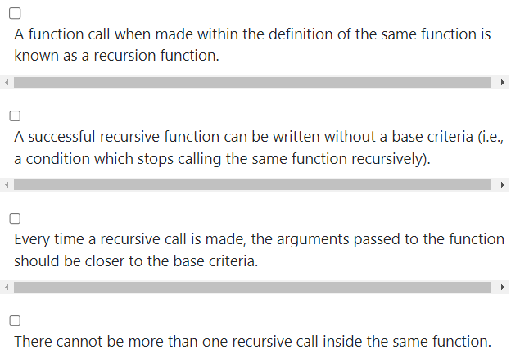

Slide 32
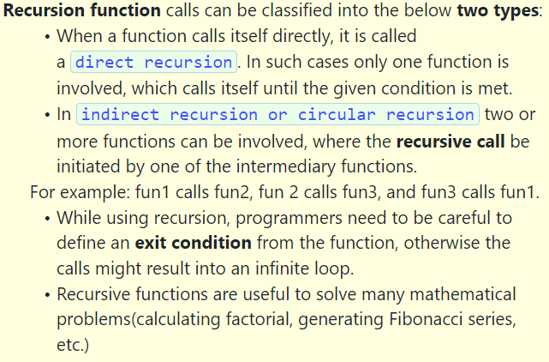

Slide 33
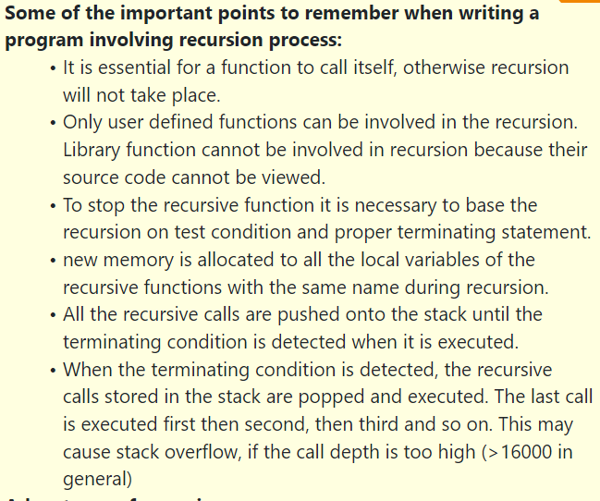

Slide 34
